Slide 1
Smart HR
23CCE286 Database Managemnet System
Lithigesh P G – [CB.EN.U4CCE23025]
Nivas G – [CB.EN.U4CCE23030]
Praveen S – [CB.EN.U4CCE23035]

Slide 2
Table of contents
01
02
03
Problem Statement
Metadata
ML Algorithms planned to deploy
04
05
Expected Outcome
Bi-Weekly Plans

Slide 3
MOTIVATION
Inefficiencies in Traditional HR – Manual processes in HR management lead to errors, delays, and inefficiencies.
Need for Automation – Automating tasks like payroll, employee records, and onboarding improves accuracy and saves time.
Enhancing Employee Experience – A centralized system simplifies access to records, benefits, and performance tracking.
Compliance & Legal Adherence – Ensuring organizations follow labor laws and internal policies efficiently.
Data-Driven Decision Making – HR analytics help organizations track employee performance, training needs, and retention strategies.
Scalability for Future Growth – A digital HR system can easily adapt as the company expands, reducing administrative burden.

Slide 4
OBJECTIVE
Centralized Employee Management – To create a unified system for storing and managing all employee-related data, including personal details, job history, and payroll records.
Automation of HR Processes – To automate key HR functions such as onboarding, payroll processing, and leave management, reducing manual effort and increasing efficiency.
Improved Workforce Coordination – To enhance coordination between HR departments and employees by providing a structured and transparent flow of information.
Enhanced Data Security – To ensure the confidentiality and protection of sensitive employee data, complying with organizational policies and legal regulations.
Scalable and Efficient System – To develop a scalable HR solution that can adapt to the organization's growth and integrate seamlessly with other business tools.
Optimized Employee Lifecycle Management – To effectively manage the entire employee lifecycle, from recruitment to exit, ensuring a smooth and well-documented transition process.

Slide 5
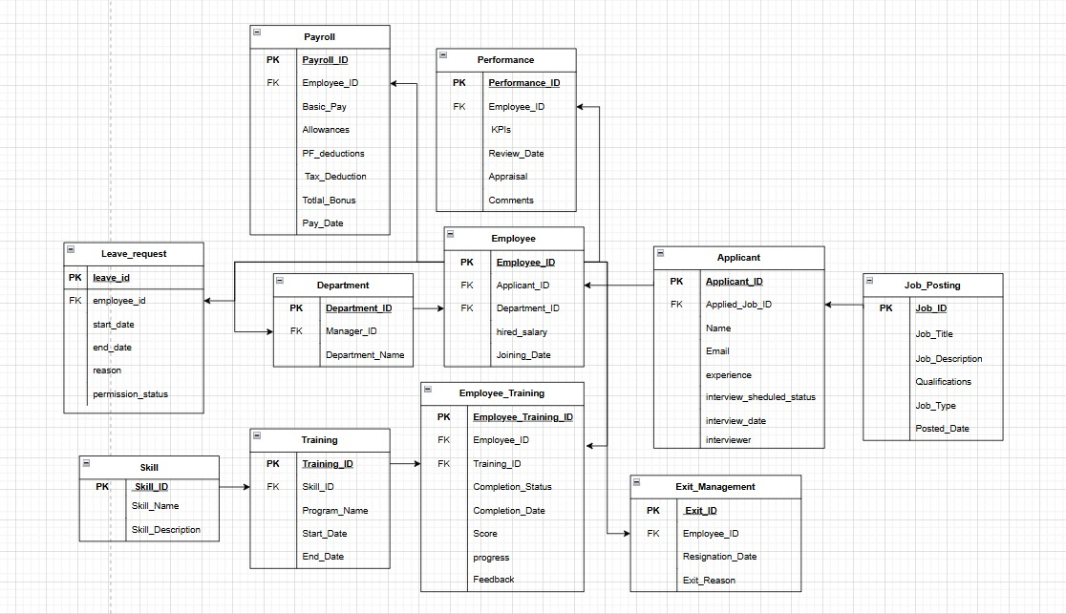
SCHEMA DIAGRAM

Slide 6
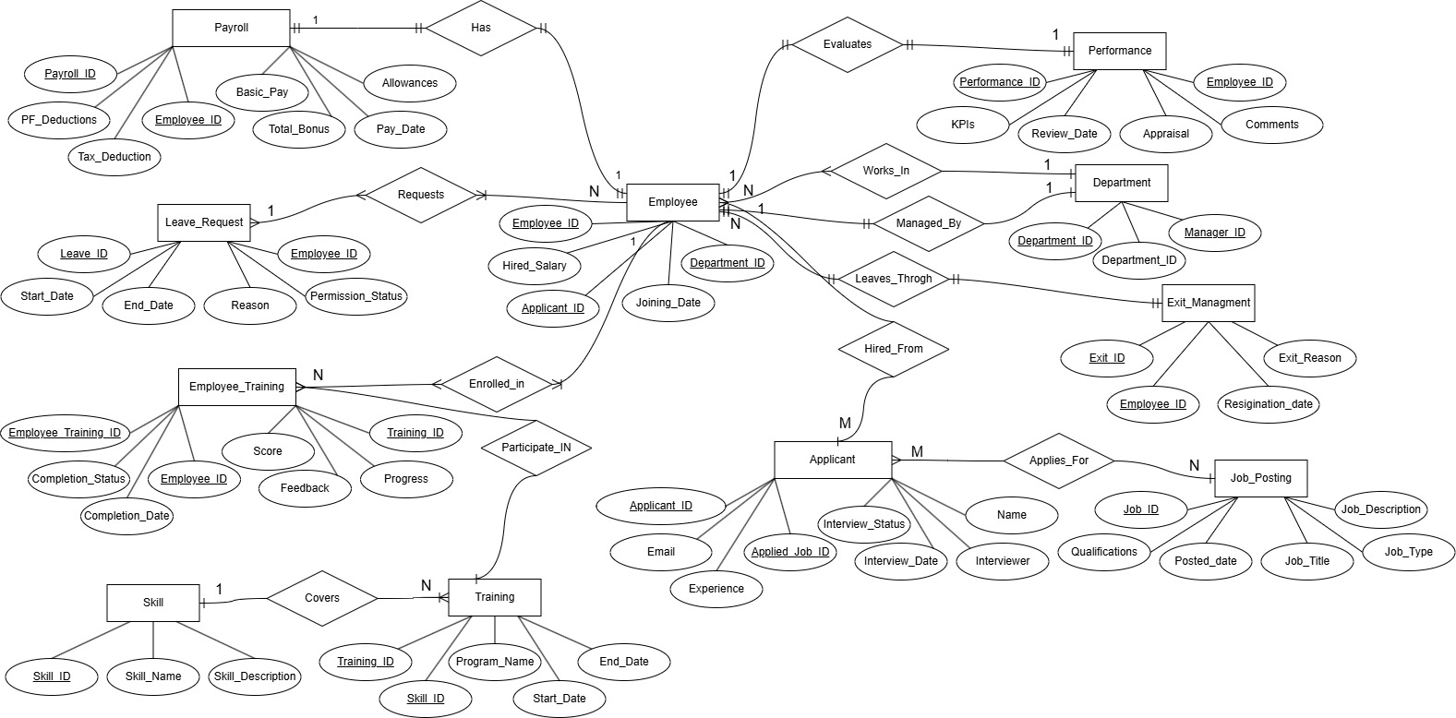
ER DIAGRAM

Slide 7
This ER diagram provides a comprehensive overview of the data structure needed to manage various HR processes, such as payroll, performance evaluation, employee training, leave requests, job postings, and exit management. It highlights the relationships between different entities, which is crucial for maintaining data integrity and ensuring efficient HR operations.
This ER diagram represents the comprehensive database structure of the Smart HR System, covering essential modules for human resource management. It includes:
Centralized employee records linked to departments, payroll, performance reviews, and training.
Tracking of applicants through job postings and interview processes.
Management of employee leave requests with detailed statuses.
Salary calculations with tax deductions, bonuses, and allowances.
Mapping of training programs and skill acquisition to employees.
Tracking of employee resignations and exit reasons for seamless offboarding.
This relational model ensures robust data relationships for efficient HR operations.

Slide 8
PROGRESS ACHIEVED
ER diagram, Schema diagram, Web Layout has been completed.
Completed the user interface(UI) for Login, Dashboard, Recruitment, Relations, Payroll, Training, Performance, Leave request
Done responsive design which is suitable for both mobile and desktop’s

